Slide 1
Introduction to Java for Business BU350.700.51 Spring I 2025
Some Java Built-In Methods

Slide 2
Some Useful Math Methods
sqrt( arg ) | Calculates and returns the square root of arg. Both arg and the return value are of type double.
pow( arg1, arg2 ) | Calculates and returns the value of arg1 raised to the arg2 power. The arguments and return value are of type double.
random() | Generates a pseudo-random number in the range [0, 1). The return value is of type double.
min( arg1, arg2 ) | Returns the minimum of arg1 and arg2. Defined for int, long, float, double.
max( arg1, arg2 ) | Returns the maximum of arg1 and arg2. Defined for int, long, float, double.
round( arg ) | Returns arg rounded up to the nearest int or long.

Slide 3
Java Variables
public class PowerMethodDemo
{
public static void main( String [] args )
{
int i = 2;
int j = 3;
System.out.println( “result = “ + Math.pow( i, j ) );
}
}

Slide 4
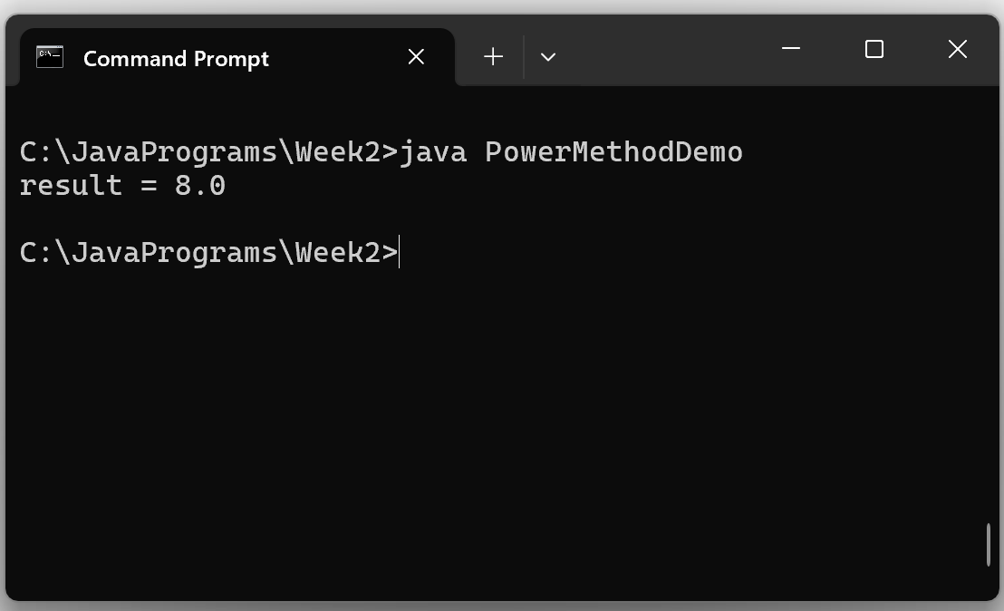
PowerMethodDemo Program Output

Slide 5
The sqrt() Method
public class SqrtMethodDemo
{
public static void main( String [] args )
{
System.out.println( “sqrt = “ + Math.sqrt( 3F ) );
}
}

Slide 6
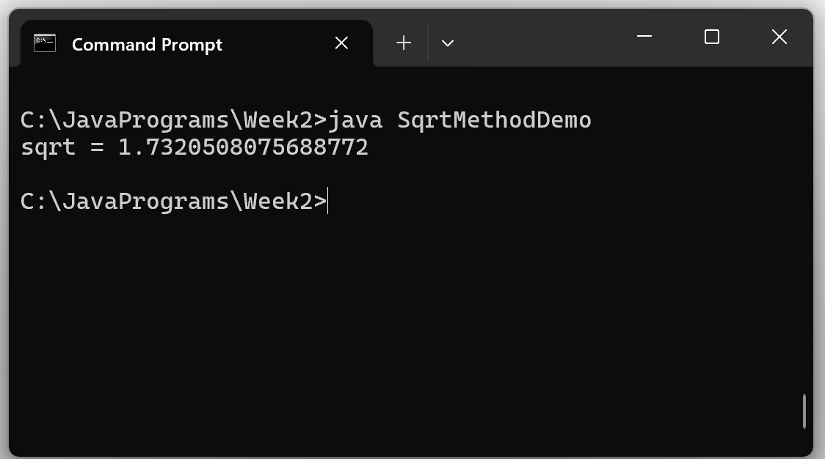
SqrtMethodDemo Program Output

Slide 7
The random() Method
public class RandomMethodDemo
{
public static void main( String [] args )
{
int ones = 0;
int twos = 0;
int threes = 0;
int num = 0;
for( int j = 1; j <= 1000; j++ ) // Generate 1,000 integers 1-3
{
num = 1 + (int)( 3 * Math.random() );
switch( num )
{
case 1: ones++; break;
case 2: twos++; break;
case 3: threes++; break;
}
}
System.out.println( “\n” + ones + “\n” + twos + “\n” + threes );
}
}

Slide 8
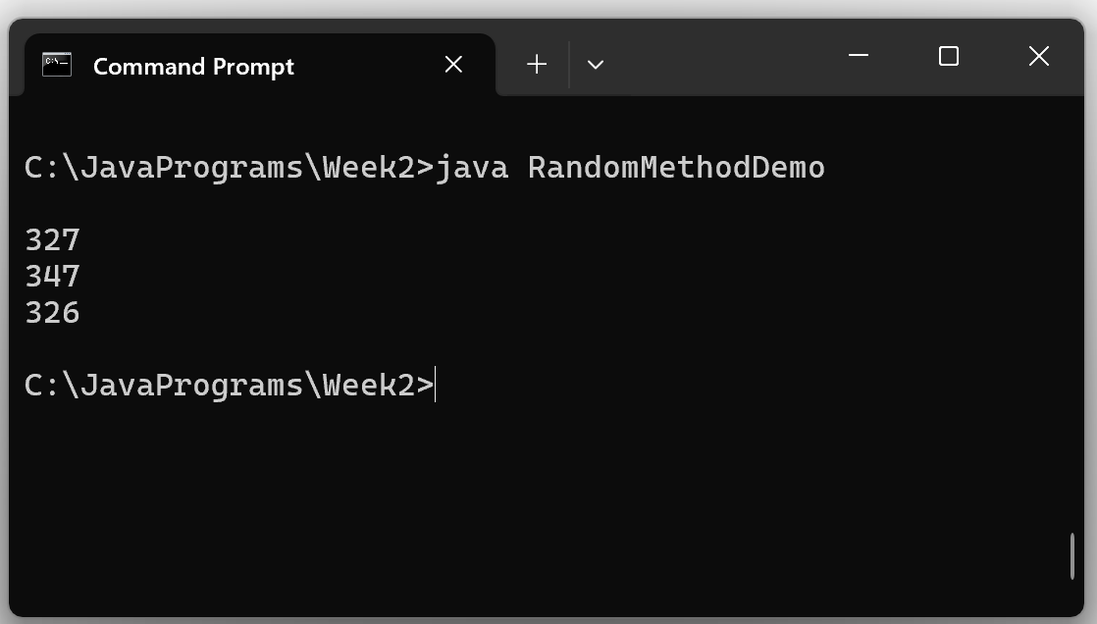
RandomMethodDemo Output

